Slide 1
ANALYTICAL MODELLING
PROCESS MODELLING

Slide 2
Classification of Process Models
Process model simulates real-world processes.
It is a relatively simple task to classify process models into one of two types: a priori or a posteriori.

Slide 3
Natural and scale analogue models
A natural analogue model uses actual events or real world objects as a basis for model construction.
A natural analogue model to predict the formation of avalanches in the previously unstudied area

Slide 4
Scale Analogue & Conceptual Model
Scale analogue models such as topographic maps and aerial photographs, which are scaled down and generalized replicas of reality.
Conceptual process models are usually expressed in verbal or graphical form, and attempt to describe in words or pictures quantitative and qualitative interactions between real-world features.

Slide 5
Mathematical models
Mathematical process models use a range of techniques including deterministic, stochastic and optimization methods.
In deterministic models, there is only one possible answer for a given set of inputs.
Stochastic models recognize that there could be a range of possible outcomes for a given set of inputs, and express the likelihood of each one happening as a probability.
Optimization models are constructed to maximize or minimize some aspect of the model’s output.

Slide 6
MODELLING PHYSICAL AND
ENVIRONMENTAL PROCESSES
In a spatial context, one of the most challenging tasks for physical and environmental modellers is forecasting what may happen in the future under a given set of conditions.
For example, predicting when and where a flood may occur or where an avalanche may take place is a difficult task.

Slide 7
MODELLING PHYSICAL AND
ENVIRONMENTAL PROCESSES
Forecasting is inherently time-dependent. Unfortunately GIS data models handle the time dimension poorly.
Most applications that involve making predictions or forecasts are based around some non-GIS model.

Slide 8
MODELLING PHYSICAL AND
ENVIRONMENTAL PROCESSES
Forecasting models tend to be dynamic, with one or all of the input variables changing over time.
For example, in the case of a forest fire, as time elapses from the start of the fire the prevailing weather conditions will change, as will the amount of forest still left to burn.

Slide 9
MODELLING PHYSICAL AND
ENVIRONMENTAL PROCESSES
The rate of diffusion of the fire from its starting point is based on the spatial characteristics of the neighbourhood.
One approach to modelling fire behaviour. Their method involved three stages:
A raster approach
Aspatial Fire modelling program known as BEHAVE
The modelling capabilities of GIS

Slide 10
MODELLING PHYSICAL AND
ENVIRONMENTAL PROCESSES
A recent development in forecasting models has been to couple GIS with artificial intelligence (AI) techniques such as neural networks.

Slide 11
MODELLING PHYSICAL AND
ENVIRONMENTAL PROCESSES
Several problems make accurate forecasting very difficult. It is generally accepted that the accuracy of forecasts decreases with the length of the prediction.
The introduction of random or stochastic processes, as advocated by proponents of chaos theory may play an increasingly important role in improving the accuracy of longer-term predictions, especially models of natural systems like weather and climate.

Slide 12
MODELLING HUMAN PROCESSES
Spatial interaction models are used to help understand and predict the location of activities and the movement of materials, people and information.
For example: To predict the flow of people from their home to shops.
The ‘attractiveness’ of a store can be represented in a spatial interaction model as an attractiveness index.

Slide 13
MODELLING HUMAN PROCESSES
The concepts of supply and demand are also important for spatial interaction modelling.
Distance between an origin and a destination does not have a fixed effect on spatial interaction. The effect of distance depends on the type of activity and customers.

Slide 14
MODELLING HUMAN PROCESSES
The effects of distance and attractiveness can be studied using gravity models. These use a distance-decay function (derived from Newton’s law of gravitation) to compute interactions given the relative attractiveness of different destinations.
GIS can also be used to display the results of the modelling process as a series of accessibility contours for both origin and destination locations, or as interaction probability surfaces

Slide 15
MODELLING THE DECISION MAKING PROCESS
Outputs from process models of both human and physical systems are the raw information that will be required to assist various types of decision-making.
Map overlay is the traditional technique for integrating data for use in spatial decision making.
For example, in siting nuclear waste facilities
Overlay analyses suffer from certain limitations when dealing with decision-making problems of a less well-defined nature.

Slide 16
MODELLING THE DECISION MAKING PROCESS
Digital map overlays
Most overlay procedures in GIS
When mapping variables for overlay analysis
One way to address these problems is to use multicriteria evaluation (MCE) techniques to either supplement or replace standard map overlay in GIS.

Slide 17
MODELLING THE DECISION MAKING PROCESS
MCE is a method for combining data according to their importance in making a given decision.
MCE techniques are numerical algorithms that define the ‘suitability’ of a particular solution

Slide 18
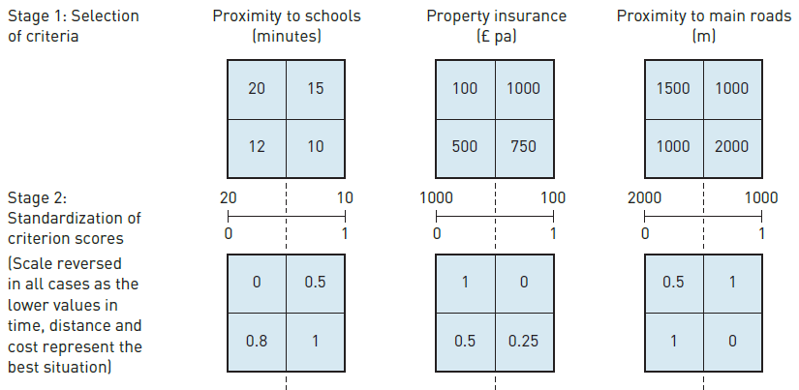
MCE algorithm is the weighted linear summation technique.

Slide 19
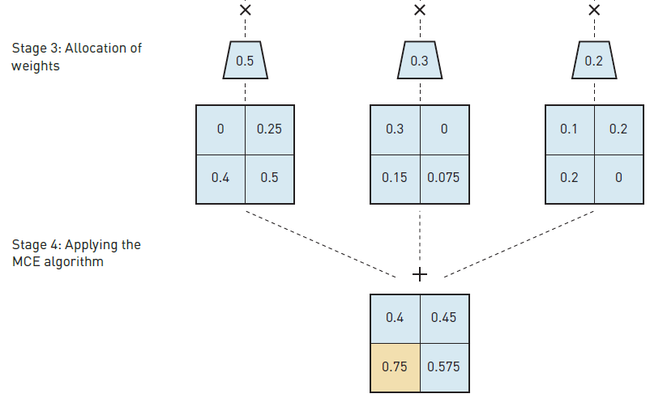
MCE algorithm is the weighted linear summation technique.

Slide 20
MODELLING THE DECISION MAKING PROCESS
GIS is an ideal framework in which to use MCE to model spatial decision-making problems as it provides the data management and display facilities lacking in MCE software.

Slide 21
PROBLEMS WITH USING GIS TO
MODEL SPATIAL PROCESSES
The use of GIS to facilitate the development of spatial process models is not without problems.
There are otherconceptual problems, These include:
The quality of source data for model calibration;
The availability of data for model validation;
The implementation within a GIS;

Slide 22
PROBLEMS WITH USING GIS TO
MODEL SPATIAL PROCESSES
The complexity of modelling reality; and
The conceptual and technical problems of building multi-dimensional models.

Slide 23
PROBLEMS WITH USING GIS TO
MODEL SPATIAL PROCESSES
Similarly, models that have been developed in a non-spatial context may require detailed data inputs which, again, do not exist as spatial data sets.
Example is the Universal Soil Loss Equation, which has often been applied within a GIS context.
The equation is written as:
A = R × K × LS × C × P
where: A = average annual soil loss; R = rainfall factor; K = soil erodibility factor; LS = slope length–steepness factor; C = cropping and management factor; and P = conservation practices factor.

Slide 24
PROBLEMS WITH USING GIS TO
MODEL SPATIAL PROCESSES
Extending the measurements to a large study area, where the controlling factors can vary by orders of magnitude, is difficult.
For example, spatial variations in evapotranspiration may be estimated by combining previous field studies on different vegetation types and weather with land cover information derived from satellite imagery.

Slide 25
PROBLEMS WITH USING GIS TO
MODEL SPATIAL PROCESSES
The main GIS problem associated with validating spatial process models is therefore lack of appropriate spatial data.
Implementation of process models within GIS enforces a spatial context. When models were originally developed for non-spatial applications this can create conceptual and operational problems.

Slide 26
PROBLEMS WITH USING GIS TO
MODEL SPATIAL PROCESSES
The human and physical worlds are extremely complex and interlinked. Theories of environmental determinism suggest that human development is strongly influenced (if not determined) by the physical environment.
Agriculture is a good example. A crop may not grow naturally in an area that receives a low rainfall, so a more drought-tolerant crop may be grown instead.

Slide 27
PROBLEMS WITH USING GIS TO
MODEL SPATIAL PROCESSES
As the model becomes more comprehensive, there will be greater data requirements, increased complexity of intra-model interactions, greater opportunity for errors in both model data and model processes, and an increased likelihood that the model outputs will have little relevance to reality.

Slide 28
PROBLEMS WITH USING GIS TO
MODEL SPATIAL PROCESSES
Limitations of standard GIS data models regarding their handling of time and 3D data.
Current GIS data models employ a ‘flat Earth’ approach. Although most GIS packages allow surface modelling of some description (2.5D) and some even permit true solid 3D modelling.

